Slide 1
Lenseless Plate Reader
Data on Training Set 1 and 2

Slide 2
Total Training Data
Bead objects: 1953
Dust objects: 808
Total Objects: 2761

Slide 3
Training Data Acquired
Training Set: |  | Training Set 1 | Training Set 2 | Training Set 3 | Training Set 4 | Training Set 5 | Training Set 6 | Training Set 7 | Training Set 8
Parameters: | Bead | Yes | Yes | Yes | Yes | Yes | Yes | Yes | Yes
 | Cell | No | No | No | No | No | No | No | No
 | Dust | Yes | No | Yes | No | Yes | No | Yes | No
 | Clarity Selection | No | No | Yes | Yes | No | No | Yes | Yes
 | Sliced Images | No | No | No | No | Yes | Yes | Yes | Yes
Test Data: | Epochs Trained | 100 | 100
 | Time Trained | 2 hours | 1.5 hours
 | Validation Loss | 5.9986 | 5.018
Object Detection | Accurate? | No | No

Slide 4
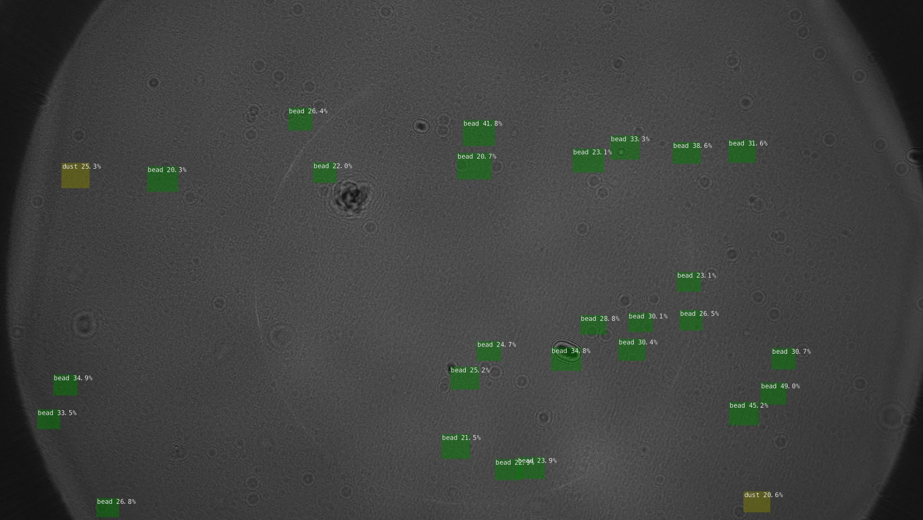
Visualization of Accuracy
Training Set 1 (beads-dust): accuracy threshold .2

Slide 5
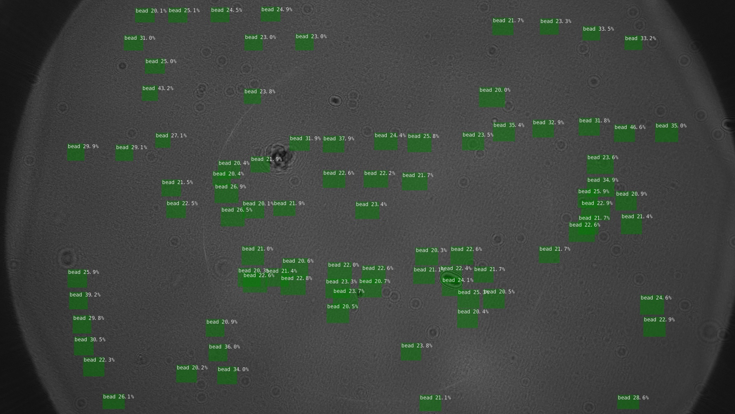
Visualization of Accuracy
Training Set 2 (beads): accuracy threshold .2

Slide 6
Next Step: Improvements
Splitting Images into smaller resolution sizes.
Selecting Clear Images for training and testing.

Slide 7
1. Splitting Images
From 3864x2080p to ~552x298p
Less features for model to work with and correlate to form objects
Development Steps:
Training:
Crop images and annotations
Detection:
Find average area, width, length of beads.
Create simple machine learning algorithm to piece together objects of edges of cropped images.

Slide 8
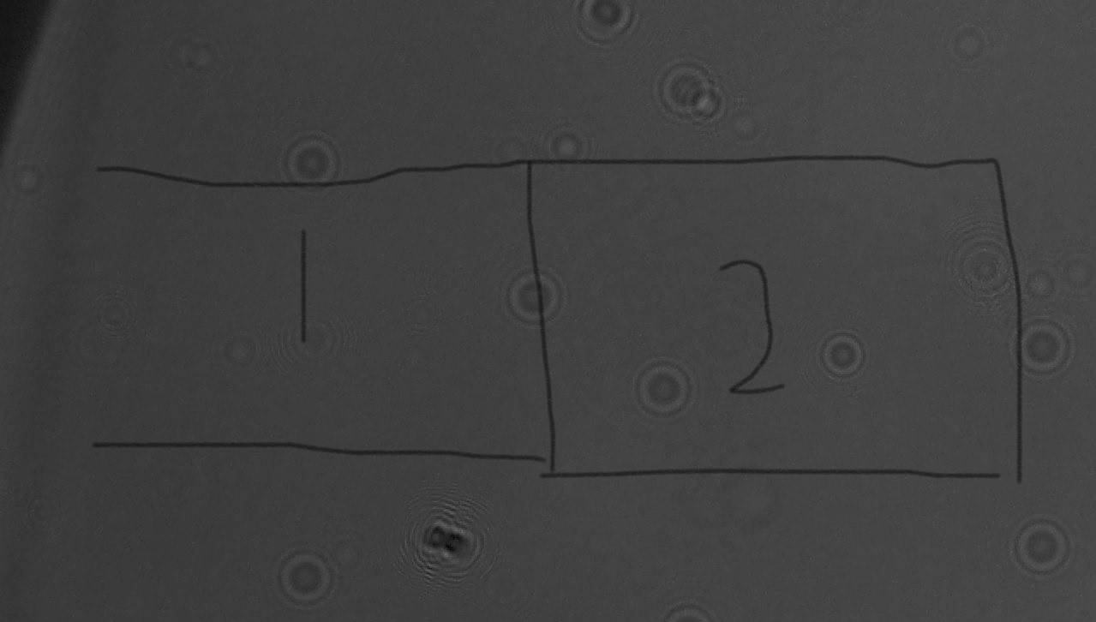
1. Splitting Images Visualization

